Slide 1
Hospital management system
Developed by TechQuilla

Slide 2
Table of contents
01
02
03
04
05
06
Introduction
Team members
Application features
UI snapshots
Tools and collaboration
conclusion

Slide 3
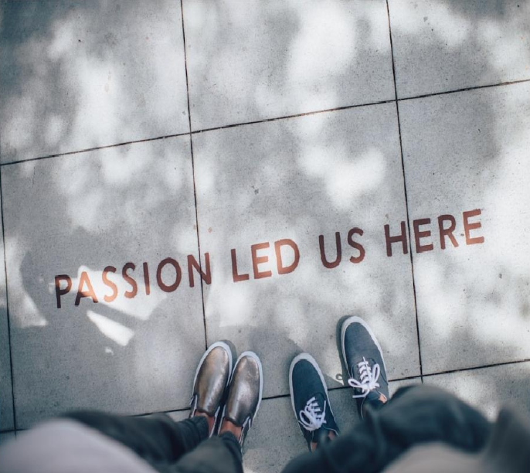
introduction
Overview – Our team has developed a comprehensive hospital management website that caters to the needs of multiple user types, including admin, staff, and owner.
Key Features – The website allows users to create schedules., book appointments, and manage various hospital-related tasks.
Objectives – The primary objective of this project was to create a user-friendly and efficient platform for managing hospital operations.

Slide 4
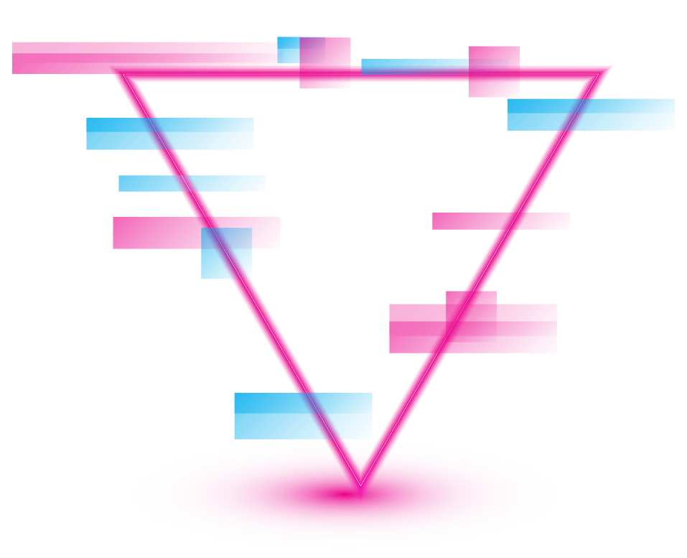
Our Team
Team Lead- Himanshu Bhatia
Front-end Developer-
Back-end Developer-
UI/UX Designer-

Slide 5
01
THE PROJECT
You can enter a subtitle here if you need it

Slide 6
Application features
Admin Features:
Doctor features
User features
Manage (add, update, delete) doctors and patients
Access comprehensive reports and analytics
View and manage schedules
Update personal information
Book and manage appointments
Check doctor availability

Slide 7
About the project

Slide 8
—Someone Famous
“This is a quote, words full of wisdom that someone important said and can make the reader get inspired.”

Slide 9

Technology stack
Languages and Technologies
Java: Backend development
HTML/CSS/JavaScript: Frontend design and interactivity
MySQL Workbench: Database management
AWS Cloud: Hosting and deployment
Development Tools
IntelliJ IDEA: IDE for Java development

Slide 10
System Architecture
Layered Architecture
Presentation Layer: HTML/CSS/JavaScript
Business Logic Layer: Java classes handling the core functionalities
Data Access Layer: MySQL database interactions
Database Layer: MySQL Workbench for database design and management

Slide 11
Project goals
Goal 1
Goal 2
Mercury is the closest planet to the Sun
Saturn is composed of hydrogen and helium
Goal 3
Goal 4
Jupiter is the biggest planet in the Solar System
Despite being red, Mars is a very cold place

Slide 12
Key concepts
Inheritance
Exception handling
Custom exceptions

Slide 13
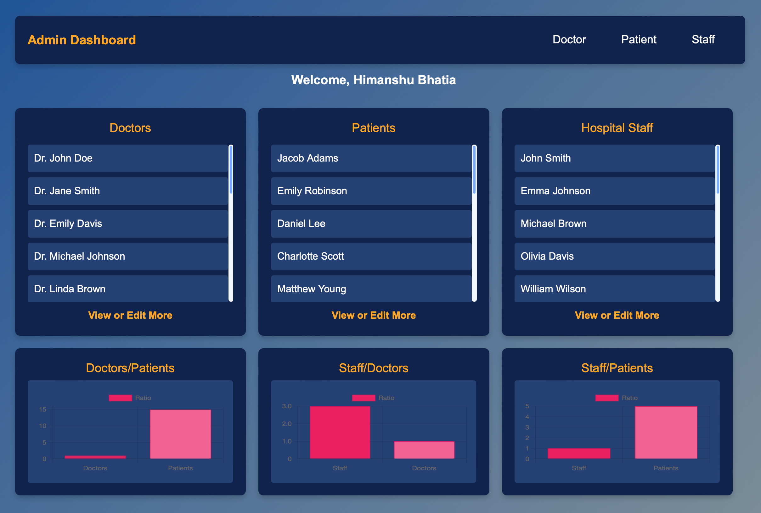
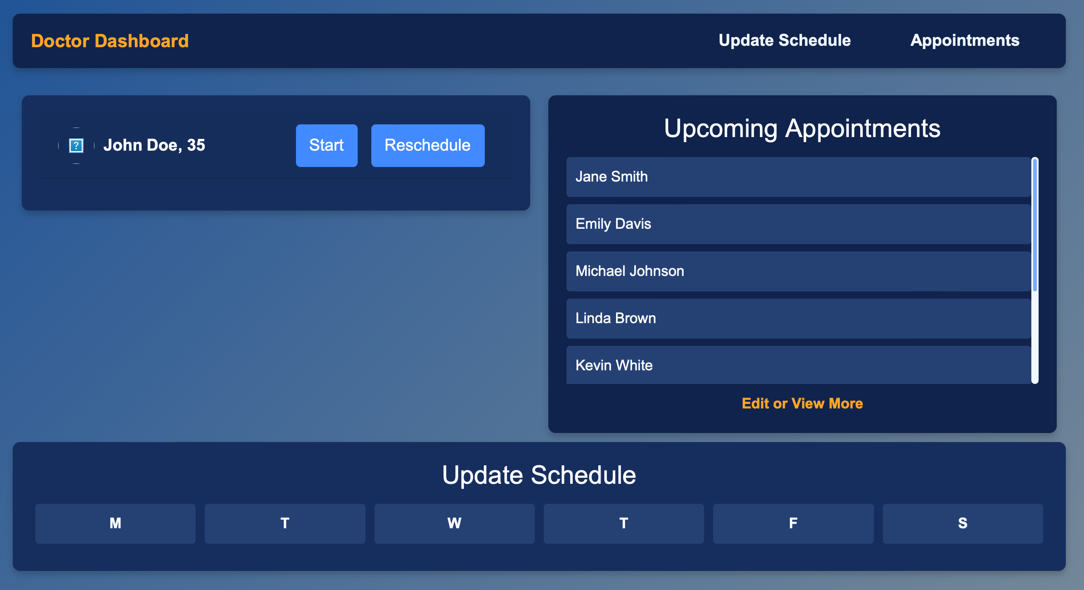
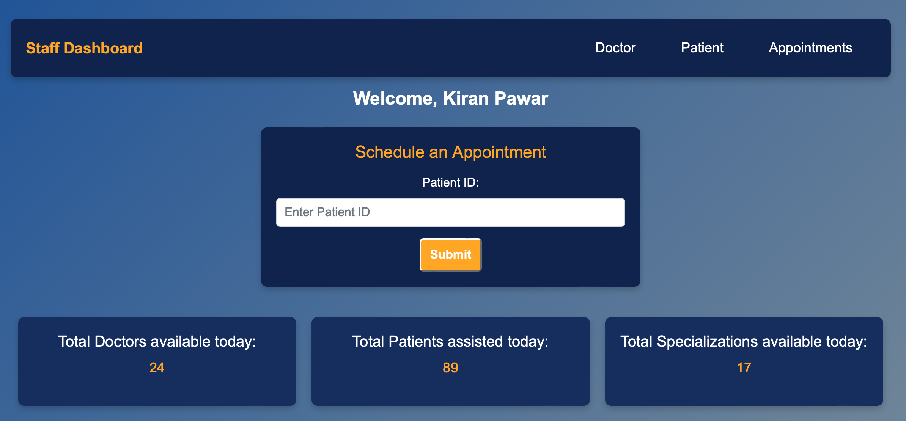
UI snapshots
Admin Interface
Doctor Interface
User Interface

Slide 14
Highlights & Achievements
02
04
Saturn
Mercury
Saturn was named after a Roman god
Mercury is the closest planet to the Sun
01
03
jupiter
Mars
Jupiter is the biggest planet in the Solar System
Despite being red, Mars is a cold place

Slide 15
Learning Outcomes
Concepts
layered architecture, exception handling
Tools
IntelliJ IDEA, AWS, and MySQL Workbench.
collaboration

Slide 16


Future Improvements
Scalability
Potential Enhancements:

Slide 17

conclusion

Slide 18
Thanks!
Do you have any questions?
addyouremail@freepik.com
+91 620 421 838
yourwebsite.com
Please keep this slide for attribution

